Slide 1




iOS - Modul 6
Dependency Managers

Slide 2
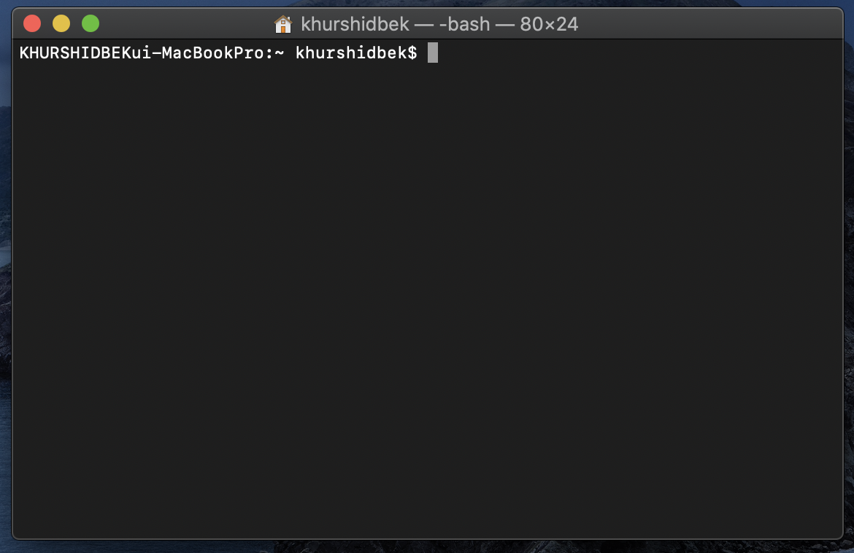
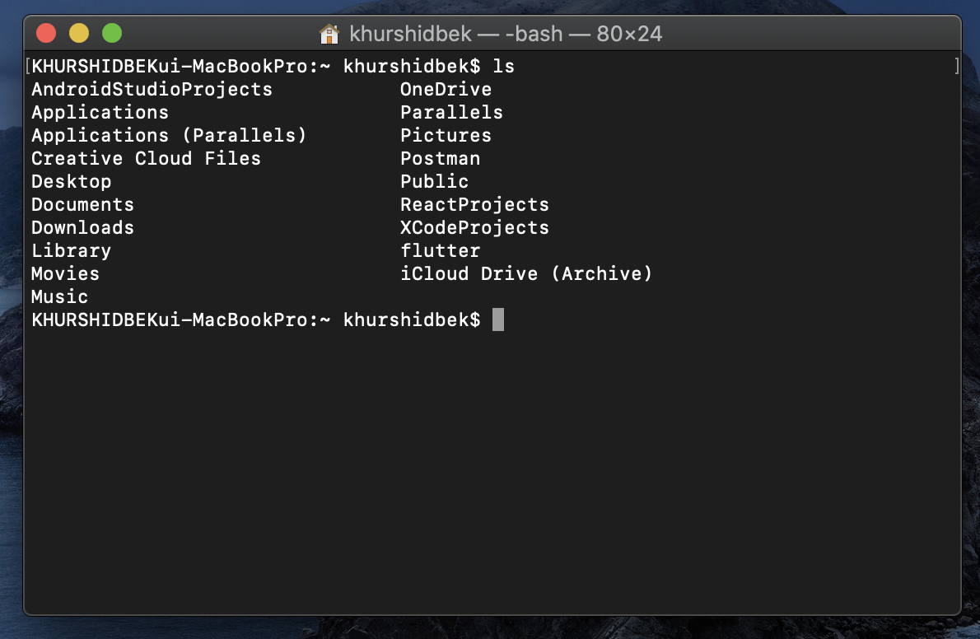
Terminal – clear & ls

Slide 3
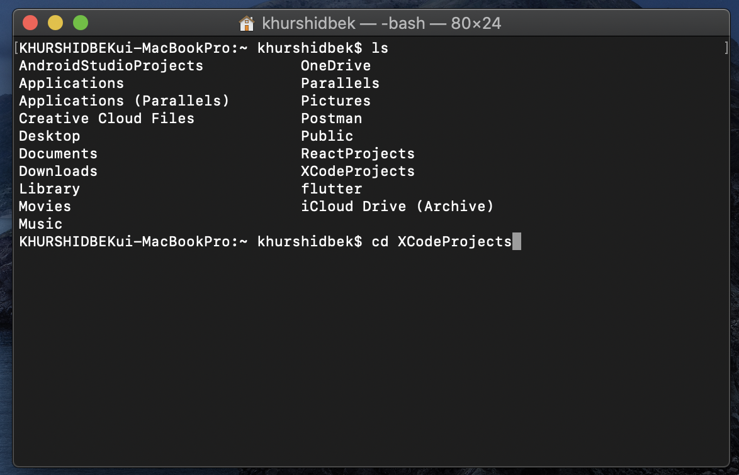
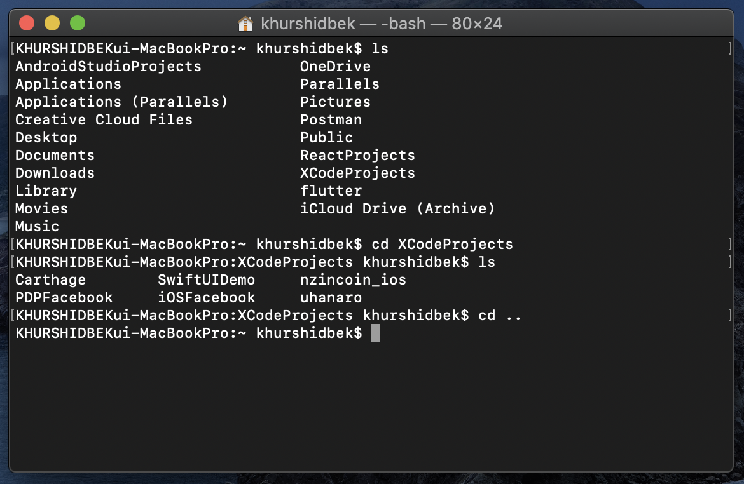
Terminal – cd & cd ..

Slide 4
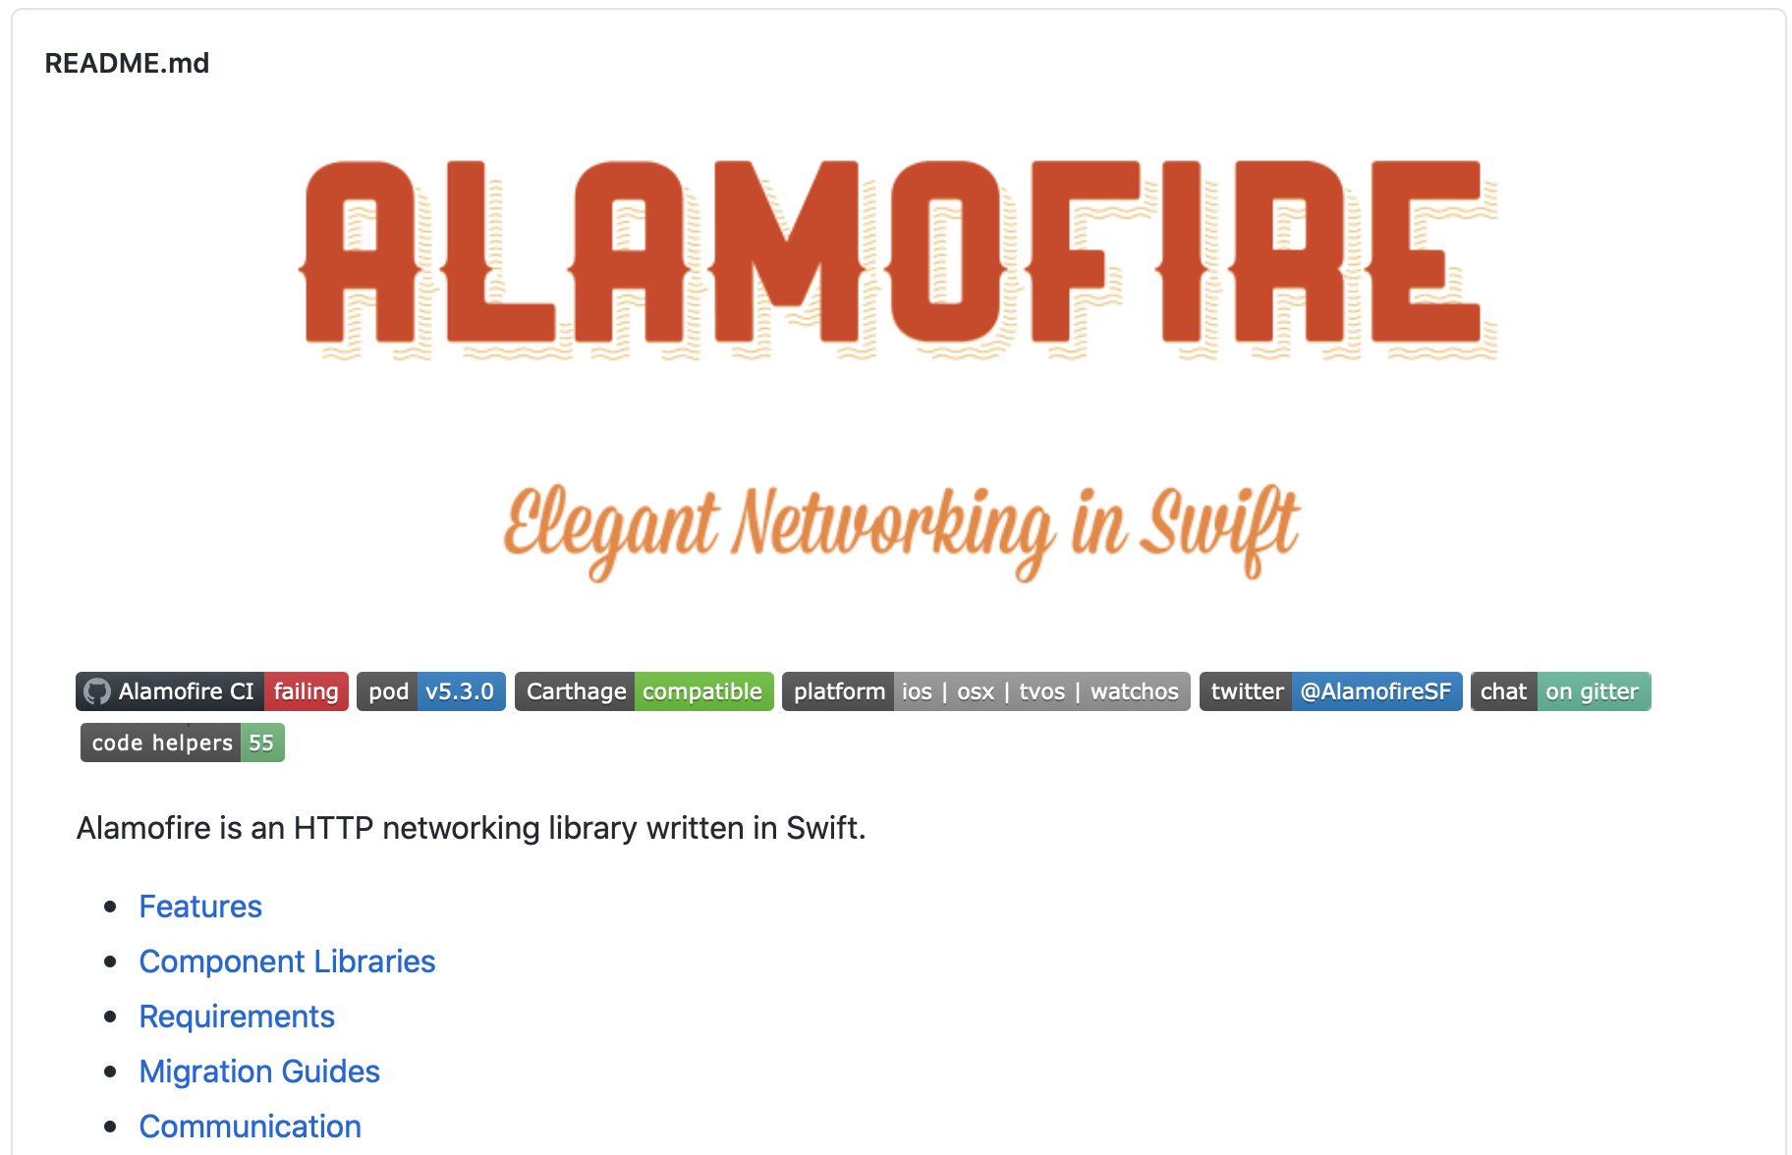
Networking Library in Github

Slide 5


iOS Dependency Managers
1- Dragging Library
2-Git Submodule
3- Carthage
4- Cocoa Pods*
5- Swift Package Manager*

Slide 6
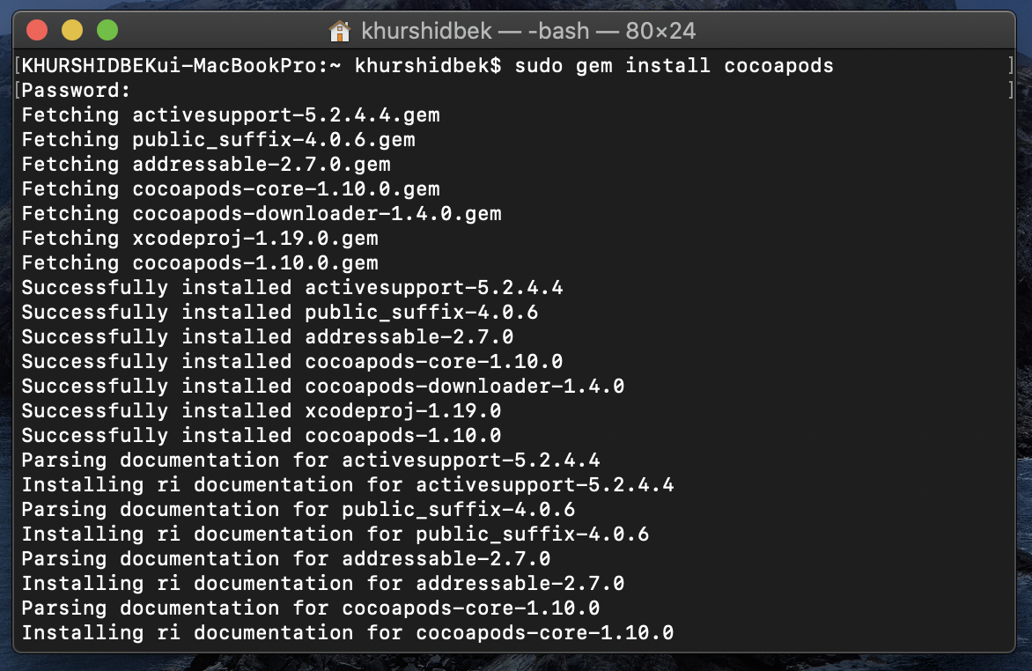
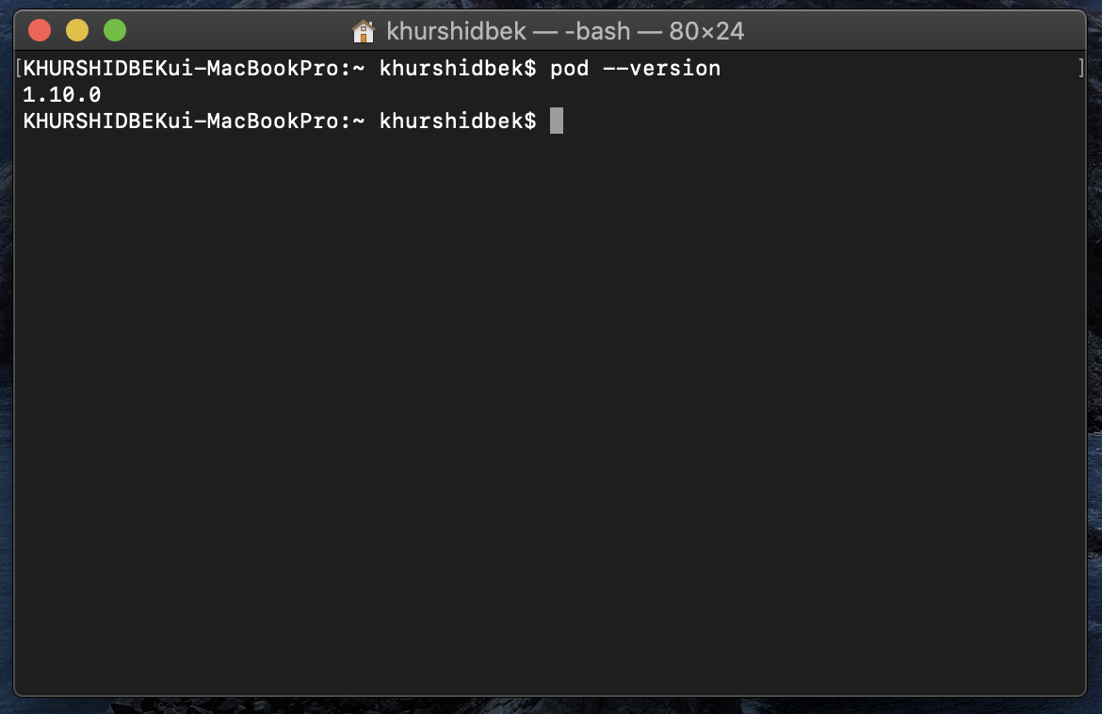
CocoaPods
https://cocoapods.org
sudo gem install cocoapods
pod --version

Slide 7
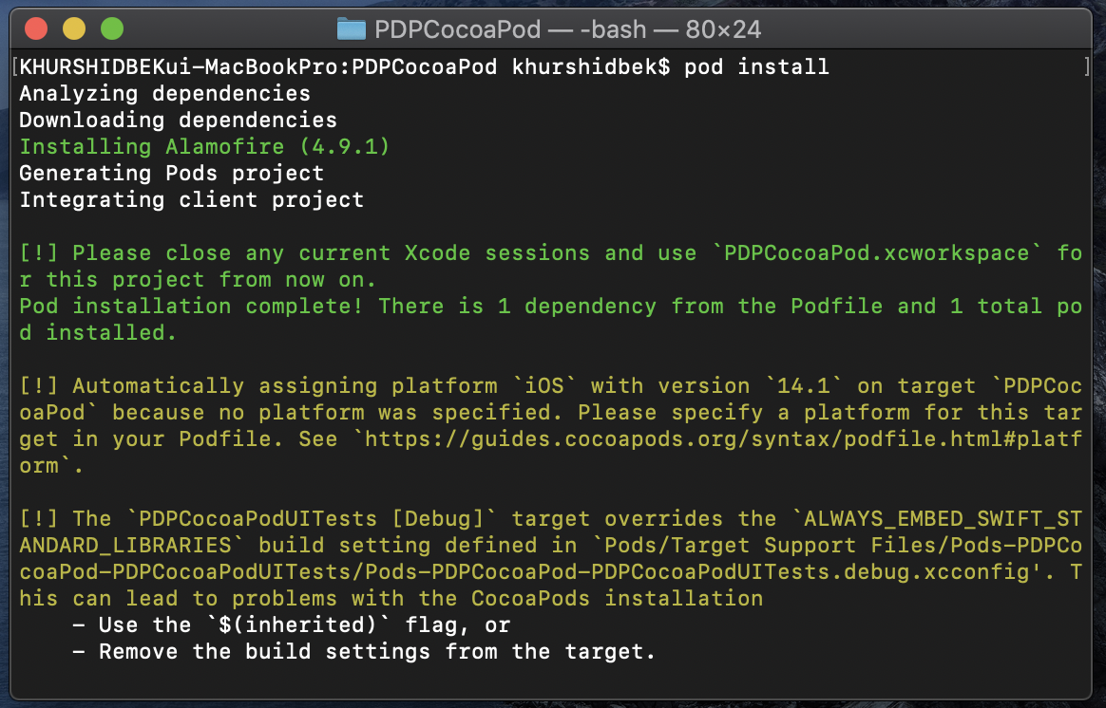
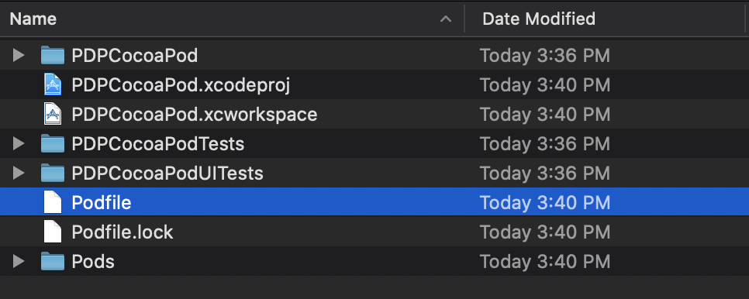
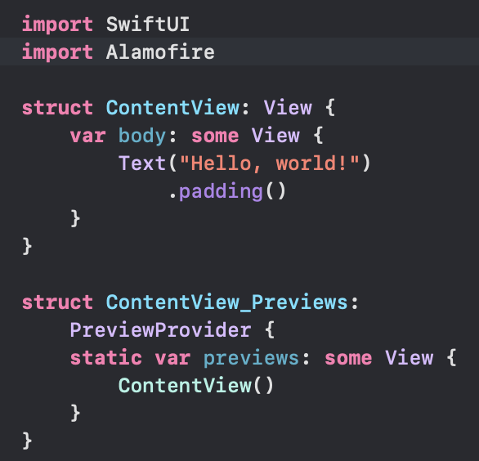
Alamofire with CocoaPods
pod init
pod install

Slide 8
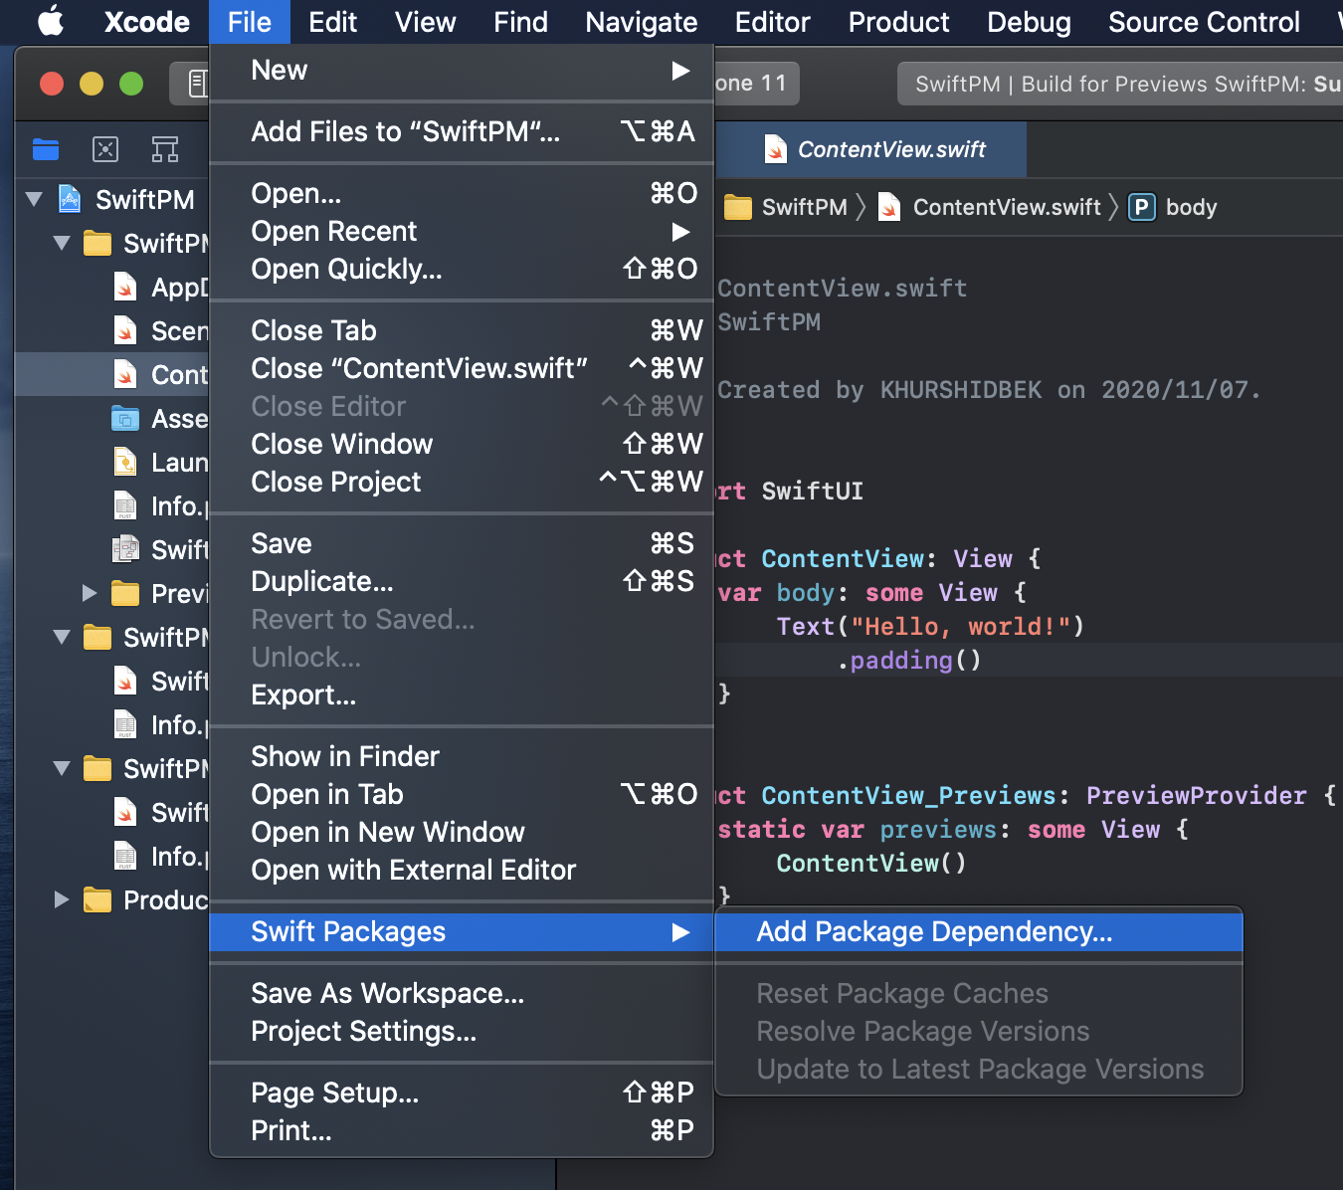
Swift Package Manager (SPM)

Slide 9
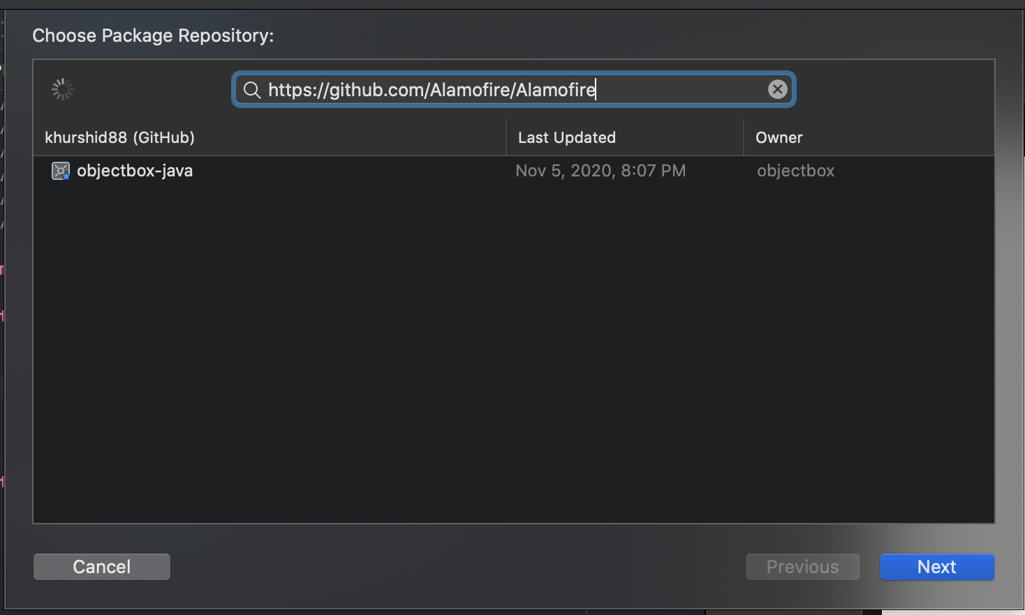
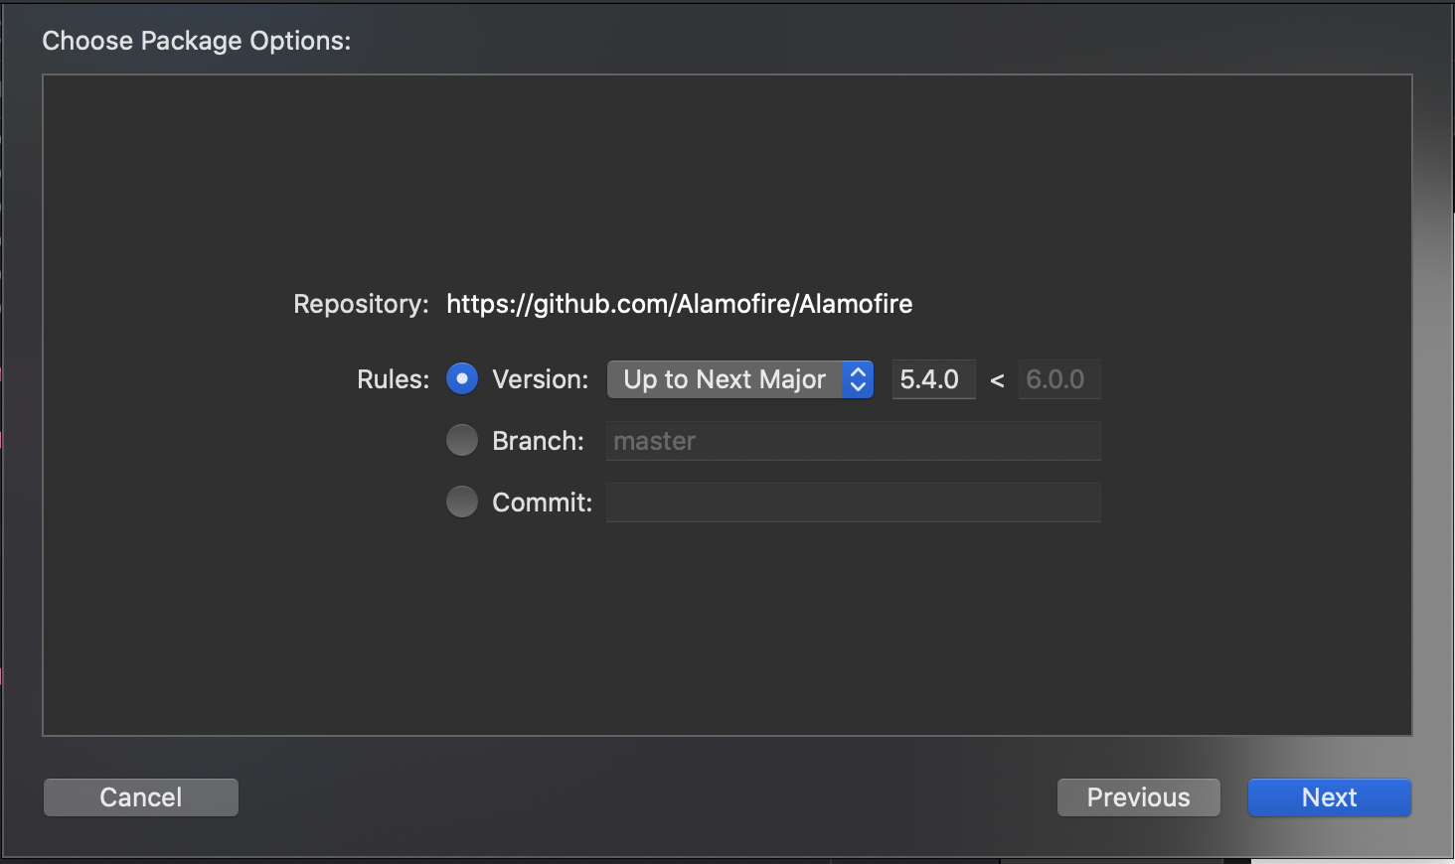
Alamofire with SMP - Github

Slide 10
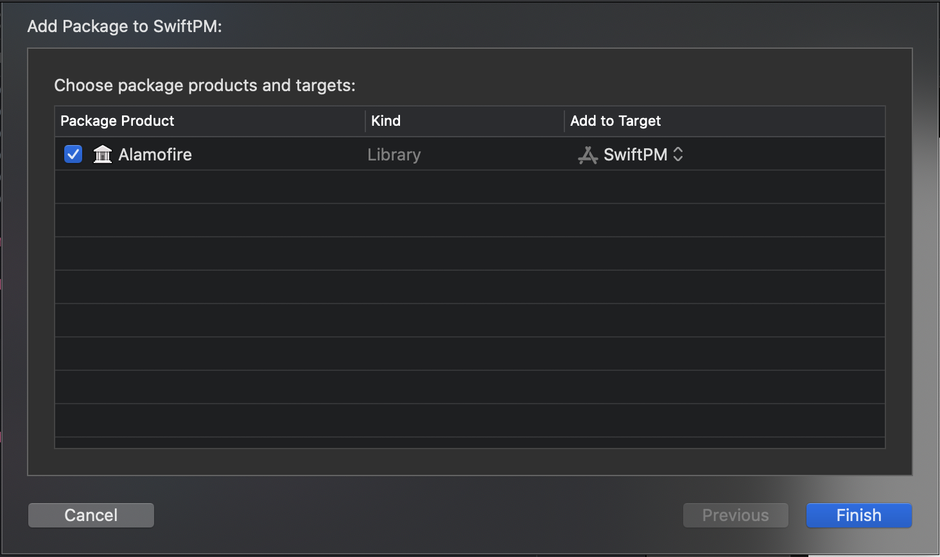
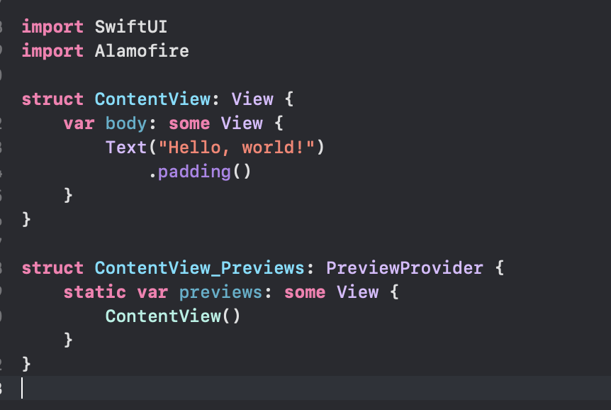
Alamofire with SMP - Target

Slide 11
Task1
Kingfisher library ni Cocopods orqali projectga o`rnating.
https://github.com/onevcat/Kingfisher
import Kingfisher
Task2
SDWebImageSwiftUI library ni SPM orqali projectga o`rnating.
https://github.com/SDWebImage/SDWebImageSwiftUI
import SDWebImageSwiftUI

